Slide 1
Parallel TCP
Weice Sun, Zhongyi LUO, Siyuan Peng, Mengying Du, Qiang Wang

Slide 2
What is Parallel TCP?
Data set is divided into a number of smaller chunks, and each component chunk is transmitted using its own TCP session.

Slide 3
Project Objective
Parallel TCP Real Implementation
NS 3 Simulation
Data Analysis

Slide 4
Parallel TCP Real Implementation
Design Principles
Coding Methods
Testing
Data Analysis

Slide 5
Sender Program Flow Chart
Divide the file into n parts
Start
Read file into socket
Destination IP file path lines to transmit
Send handshake signal with file name
No
IP exit
Get Respond
Print Error
No
Yes
File exit
Yes
Process 1,2,3…
Start Send file

Slide 6
Receiver Side
Start
Start n Processes to get info from socket
Lines to Receive
Read buffer from socket
No
Get hand shake from sender
Write buffer to file
Send back info to sender
end
Yes

Slide 7

Test Results
Exactly the same!
Data Transferred via Parallel TCP

Slide 8
Data Analysis
Is there a trend?
What this implies?
What we do next?

Slide 9
Parallel TCP fairness ---ns3 simulation
Topology:
Simulation Environment:
OSX 10.10.5 2.9 GHz Intel Core i5
ns-3.24.1
Global parameter setting:
Random seed: RngSeedManager::SetSeed(11223344)
Protocol TCP Reno
Segment Size = 512
BW and delay: 5Mbps 10ms & 1Mbps 20ms
Sender
Sink

Slide 10
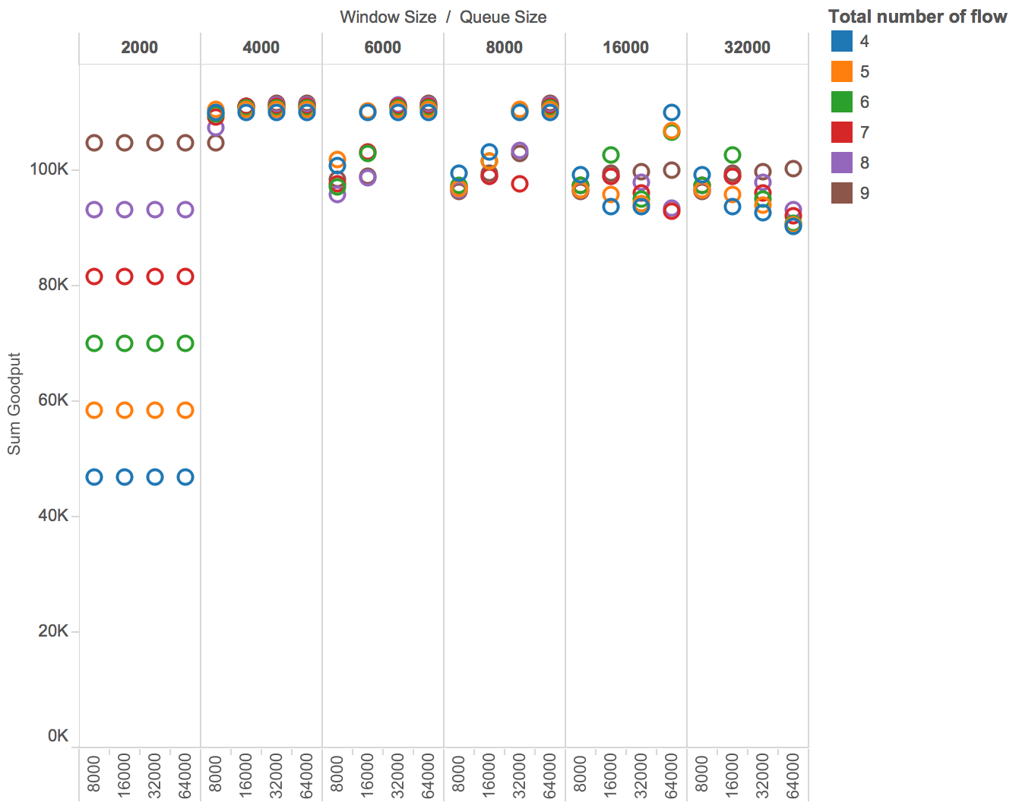
Parallel TCP throughput -- simulation result
Queuing Mode
DropTail Queue
+- 15%
{2000 Bytes
- 32000 Bytes}
Window Size
{8000 Bytes
- 64000 Bytes}
Queue Size
Port Number
{4 - 9}

Slide 11
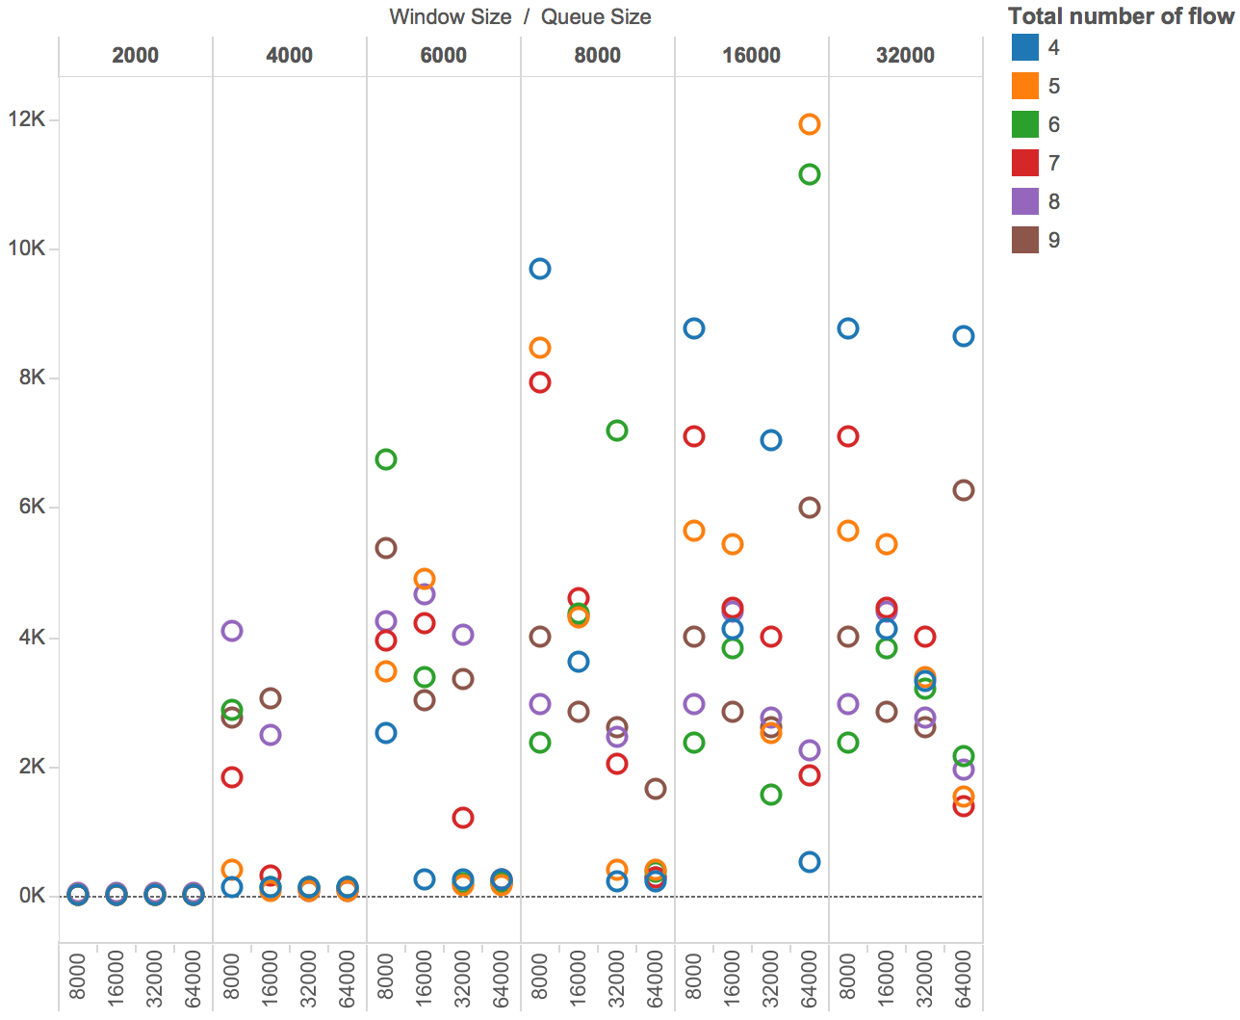
Parallel TCP standard deviation -- simulation result
Queuing Mode
DropTail Queue
Port # 4-6
{2000 Bytes
- 32000 Bytes}
Window Size
{8000 Bytes
- 64000 Bytes}
Queue Size
Port Number
{4 - 9}
Max Thresh: 0.24 * QueueSize;
Min Thresh: 0.04 * QueueSize;
Better fairness

Slide 12
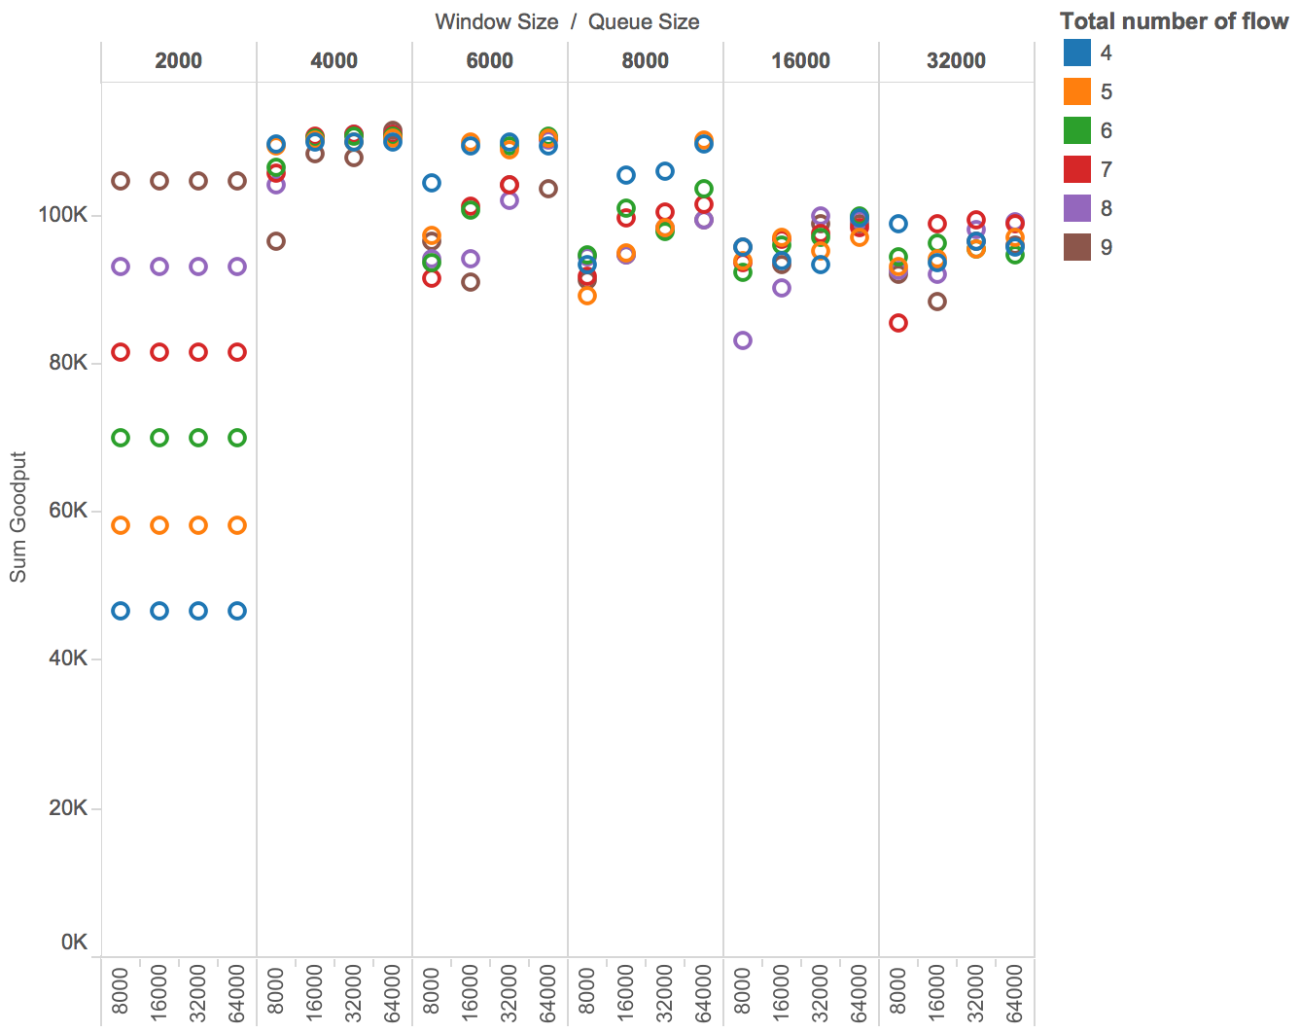
Parallel TCP throughput -- simulation result
Queuing Mode
RED
Queue
+- 10%
{2000 Bytes
- 32000 Bytes}
Window Size
{8000 Bytes
- 64000 Bytes}
Queue Size
Port Number
{4 - 9}
Max Thresh: 0.24 * QueueSize;
Min Thresh: 0.04 * QueueSize;

Slide 13
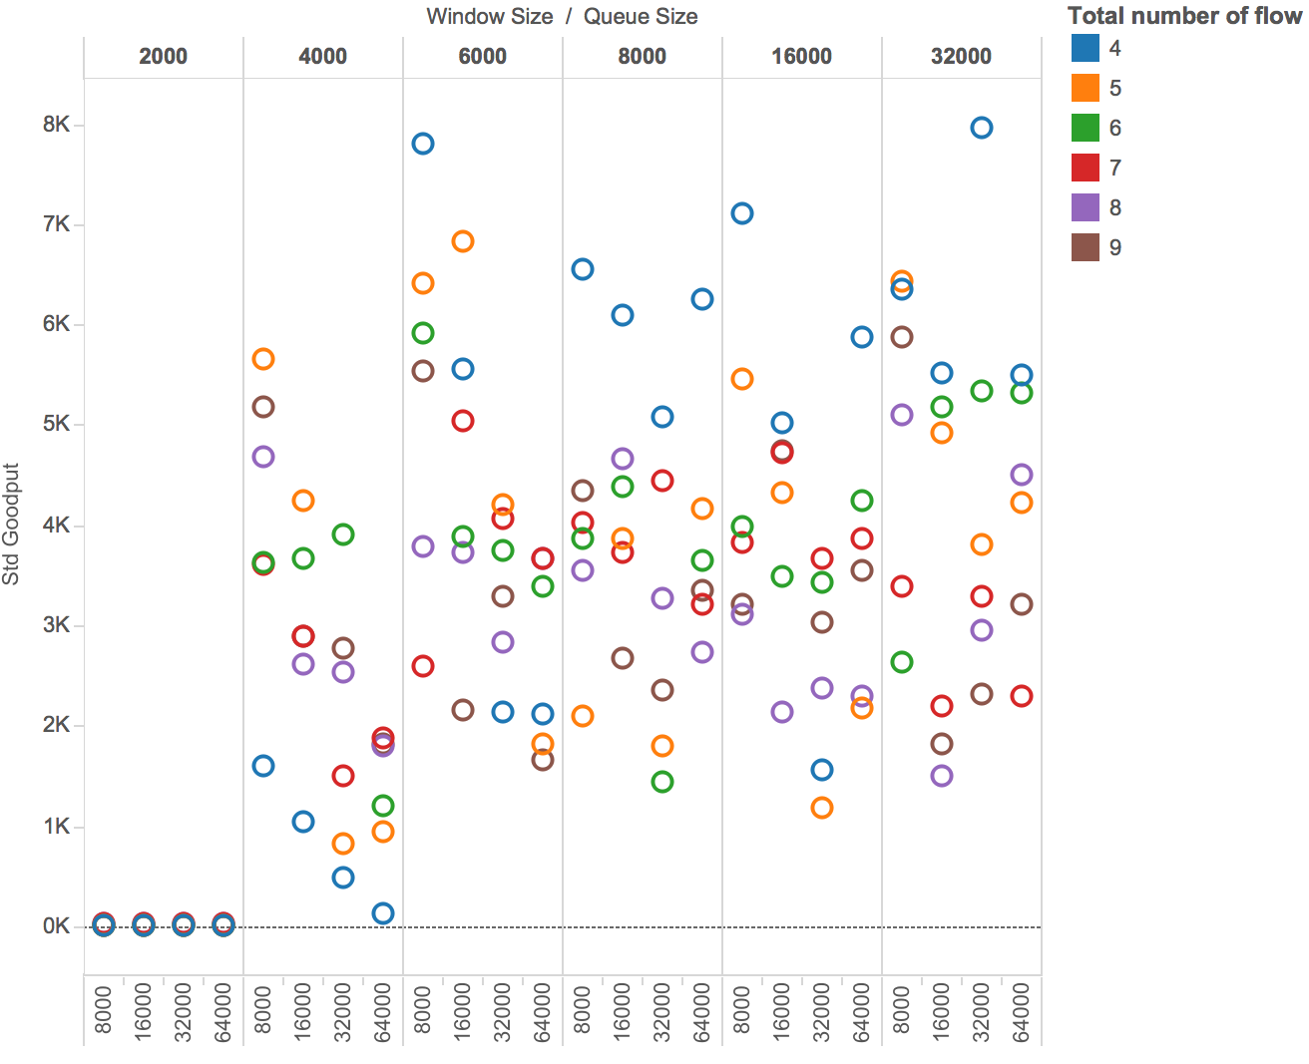
Parallel TCP standard deviation -- simulation result
Queuing Mode
RED
Queue
Port # 4-5
{2000 Bytes
- 32000 Bytes}
Window Size
{8000 Bytes
- 64000 Bytes}
Queue Size
Port Number
{4 - 9}
Max Thresh: 0.24 * QueueSize;
Min Thresh: 0.04 * QueueSize;
Better fairness

Slide 14
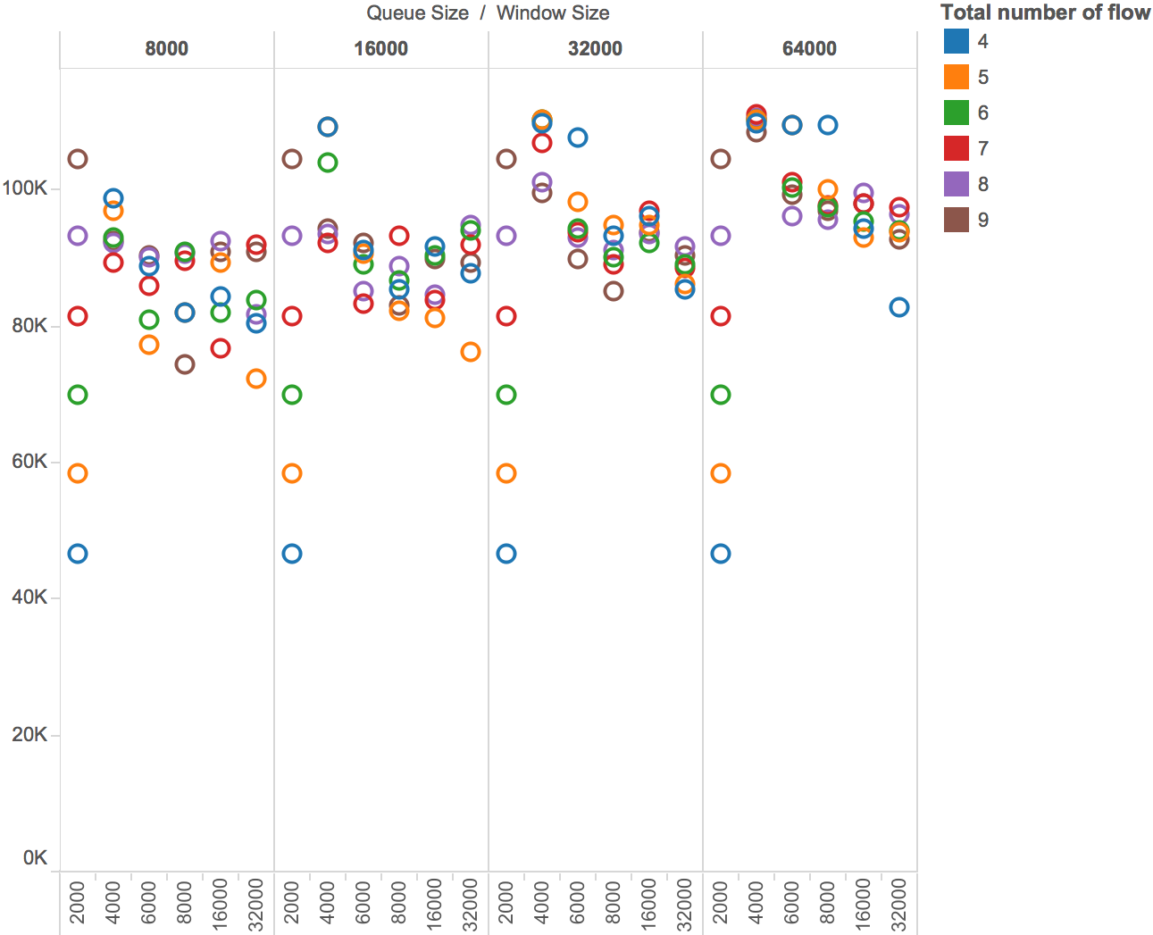
Parallel TCP throughput -- simulation result
Queuing Mode
RED
Queue
{2000 Bytes
- 32000 Bytes}
Window Size
+- 18%
{8000 Bytes
- 64000 Bytes}
Queue Size
Port Number
{4 - 9}
Max Thresh: 0.1 * QueueSize;
Min Thresh: 0.04 * QueueSize;

Slide 15
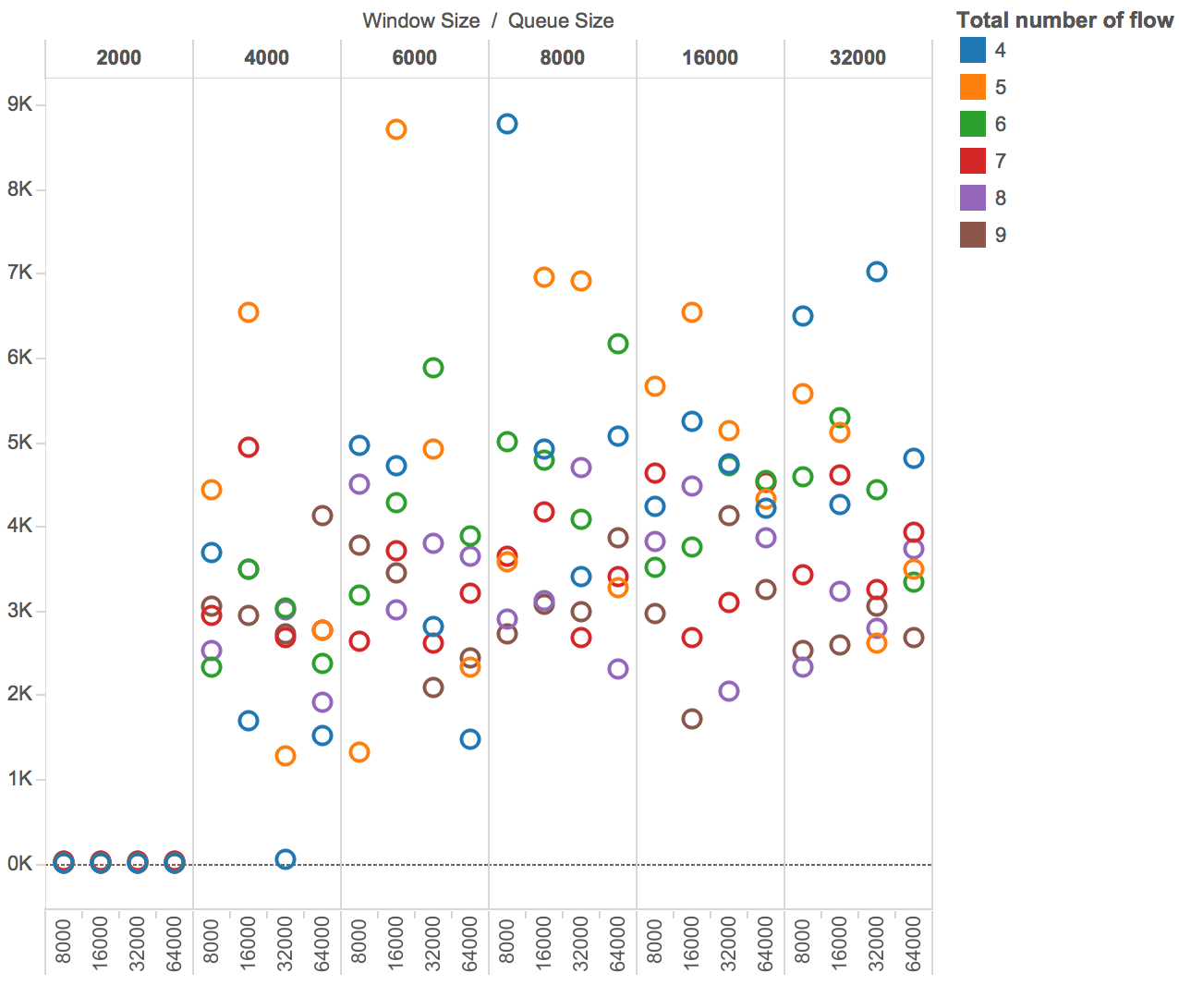
Parallel TCP standard deviation -- simulation result
Queuing Mode
RED
Queue
Port # 4-6
{2000 Bytes
- 32000 Bytes}
Window Size
{8000 Bytes
- 64000 Bytes}
Queue Size
Port Number
{4 - 9}
Max Thresh: 0.1 * QueueSize;
Min Thresh: 0.04 * QueueSize;
Better fairness

Slide 16
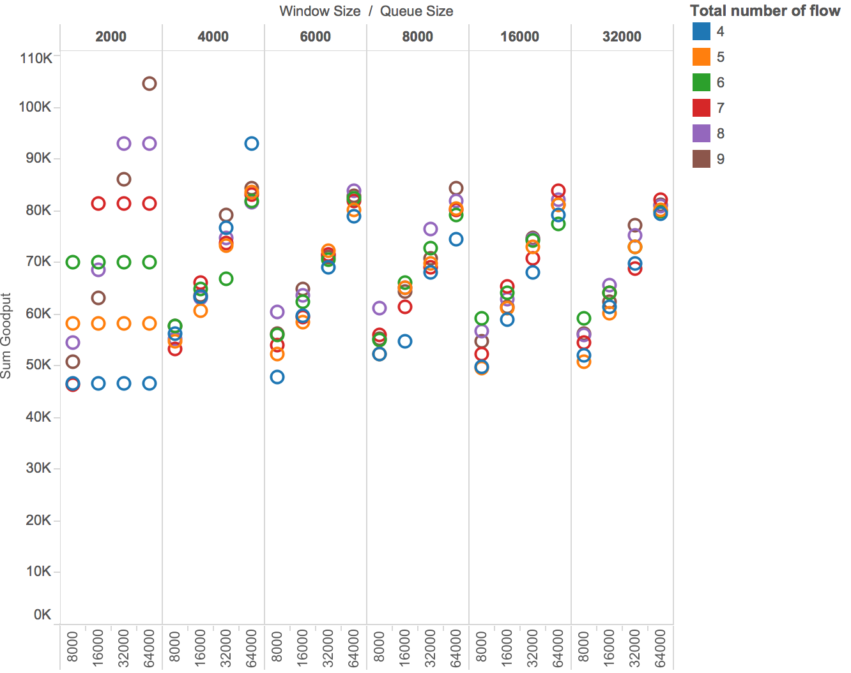
Parallel TCP throughput -- simulation result
Queuing Mode
RED
Queue
{2000 Bytes
- 32000 Bytes}
Window Size
{8000 Bytes
- 64000 Bytes}
Queue Size
+- 22%
Port Number
{4 - 9}
Max Thresh: 0.004 * QueueSize;
Min Thresh: 0.0001 * QueueSize;

Slide 17
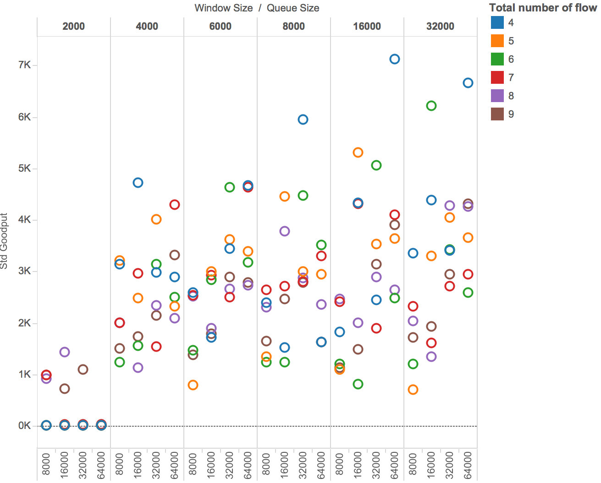
Parallel TCP standard deviation -- simulation result
Queuing Mode
RED
Queue
Port # 4-6
{2000 Bytes
- 32000 Bytes}
Window Size
{8000 Bytes
- 64000 Bytes}
Queue Size
Port Number
{4 - 9}
Max Thresh: 0.004 * QueueSize;
Min Thresh: 0.0001 * QueueSize;
Better fairness

Slide 18
ns3 simulation conclusion:
In terms of throughput:
Window Size + Queue Size
Port number
Drop Tail or RED (Threshold setting)
In terms of standard deviation:
Window Size + Queue Size
Port number
Drop Tail or RED (Threshold setting)

Slide 19
Thanks Q&A

